Slide 1
Smart Parking Simulation System

Slide 2
Traditional parking systems face many problems such as: Traffic congestion Long waiting queues Inefficient parking allocation Payment delays Proposed Solution is a smart parking simulation system that: Allocates parking slots automatically Manages waiting queues Calculates parking cost dynamically Tracks occupancy and revenue
Introduction

Slide 3
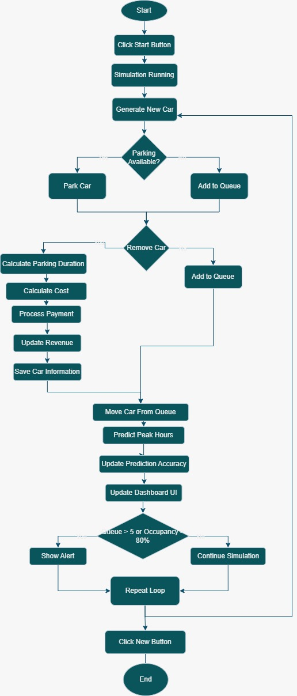
System Workflow
The simulation starts by generating random cars and checking parking availability
If a parking slot is available, the car is parked.
Otherwise, the car is added to the waiting queue.
The system calculates parking duration and cost.
Payment is processed automatically.
Revenue and occupancy are updated continuously.
The system predicts peak hours and shows alerts during high occupancy.
Queue Management.
Dynamic Pricing.
Peak Hour Prediction.
Real-Time Dashboard Updates.
Key Features

Slide 4
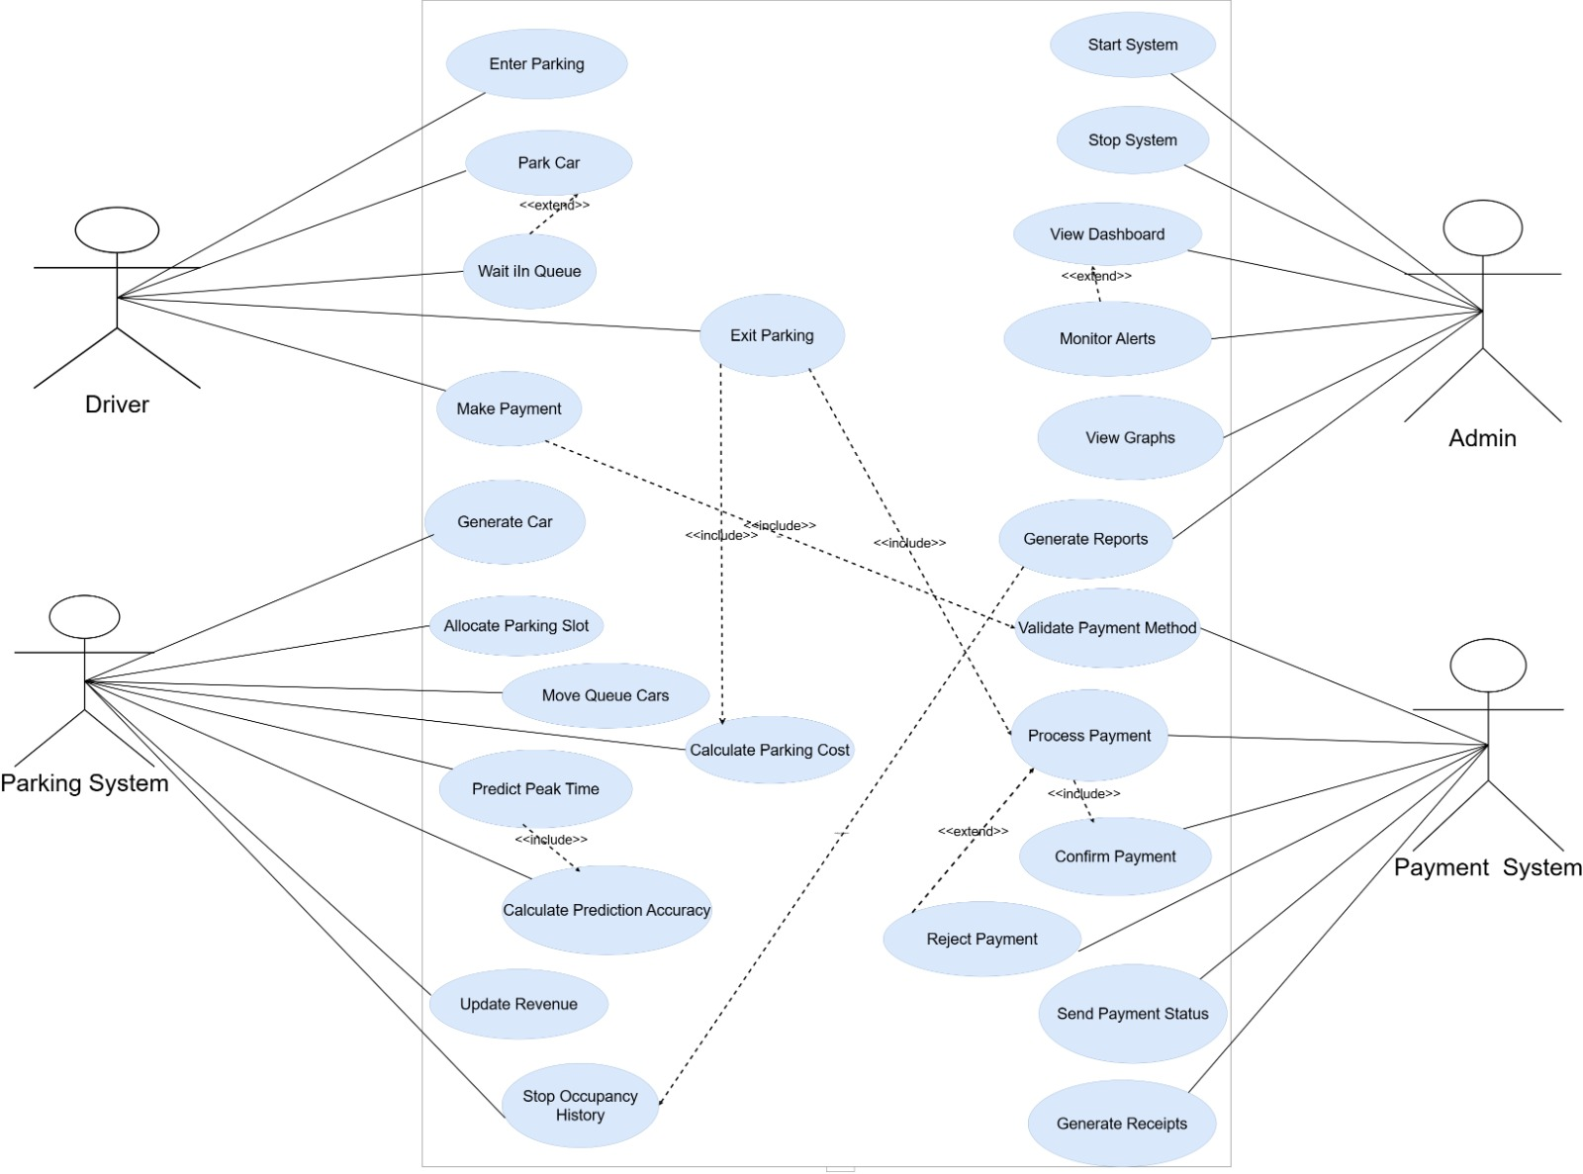
Use Case Diagram

Slide 5
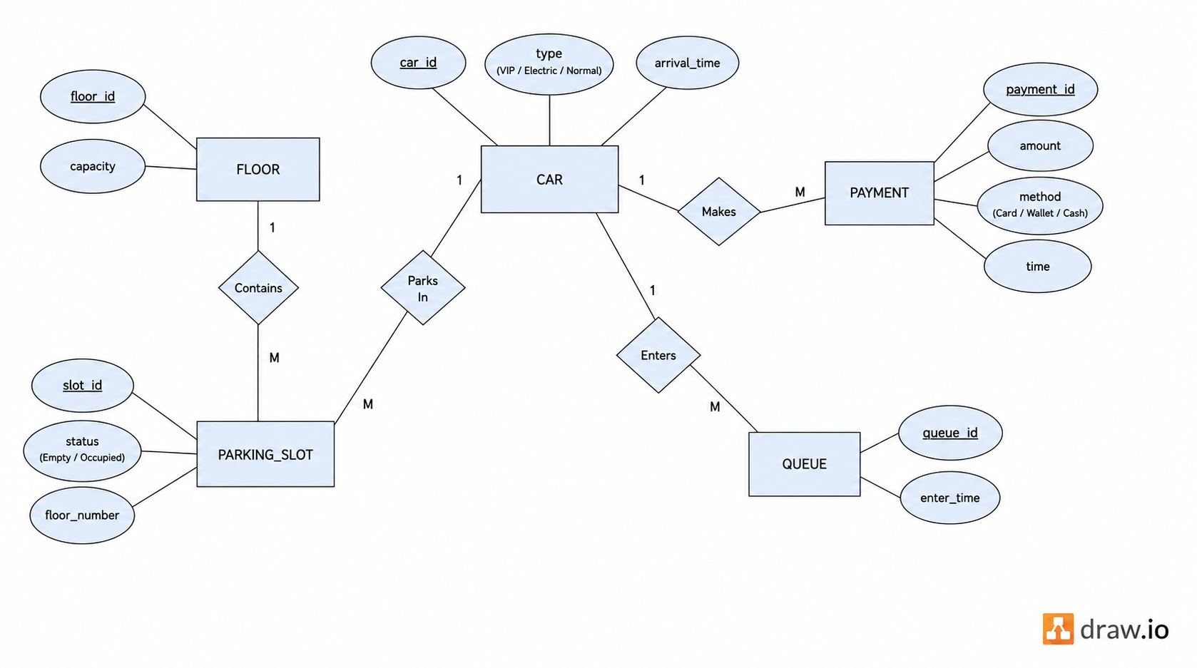
ERD Diagram
The ERD illustrates the relationships between the main system entities .

Slide 6
Problem & Solution
Problem:
Traditional parking systems suffer from congestion and long waiting queues.
Difficulty in managing parking slots efficiently.
Lack of real-time tracking for occupancy and revenue.
Slow and inefficient payment handling.
Solution:
A Smart Parking Simulation System that:
- Automatically assigns parking slots.
- Manages waiting queues efficiently.
- Calculates dynamic pricing based on conditions.
- Tracks occupancy, revenue, and car behavior in real time.

Slide 7
Conclusion
The Smart Parking System successfully simulates real-world parking behavior.
It efficiently manages parking allocation and queue handling.
Dynamic pricing improves system fairness and performance.
The system provides real-time insights through graphs and reports.

Slide 8
Thank You

